Slide 1

Generative AI: Navigating Short-term Skepticism and Long-term Promises
Team Members
Bhuwan Thapa
Pratik Sing Dhami
Basanta Adhikari
Kiran Bhusal

Slide 2

Outline
Introduction
System Overview
Delivered Technical Artefacts
Conclusions

Slide 3

Introduction
Describe about the challenges and opportunities presented by generative AI in cybersecurity.
Balance the current skepticism surrounding GenAI and its long-term potential mainly in the context of cybersecurity applications.
Develop a comprehensive strategy for security leaders to effectively integrate along with managing associated risks and ethical issues.
Provide a proper framework for the ethical implementation of GenAI and conduct a thorough risk assessment and provide risk mitigation plan.
This project includes the development of GenAI tools and deploy into the websites hosting in AWS web server.

Slide 4
System Overview
Problems from Business/Technical Perspective
Technical Requirements
System Diagram
Design of Network/Security Architecture
Industry Analysis for GenAI and Stakeholder Identification
Framework for GenAI Implementation
Risk Assessment and Mitigation plan
Collaborative Training and Awareness program

Slide 5

Problems from Business and Technical Perspective
Business Perspective
Intellectual property concern
Economic disruption
Managing expectation
Technical Perspective
Security Threats and Vulnerabilities
Ethical Implementation
Data Quality and Bias
Technical Expertise and Collaboration
To address this issues, we have provided four recommendations mentioned in the project specifications and we will describe it slides below.

Slide 6

Technical Requirements
Understanding of large language models (LLM) like ChatGPT and Gemini and their applications in cybersecurity.
Programming language Python.
Website design and development.
Deployment process.
Subscriptions of Microsoft Azure / AWS web server.

Slide 7
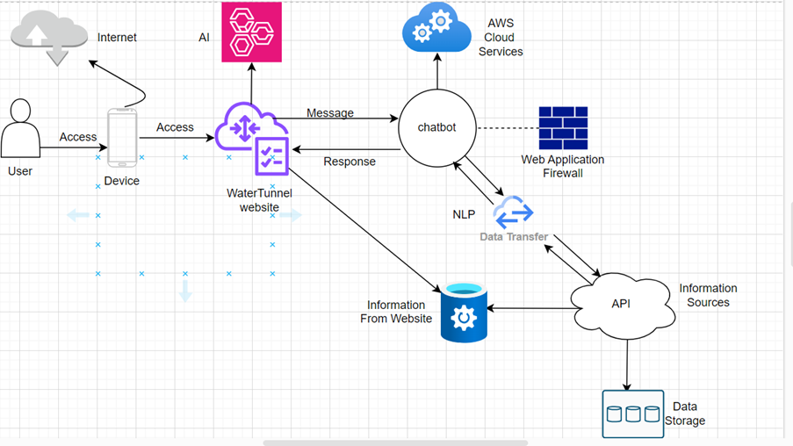
Network Design
This figure describes the complete process of user accessing website hosting on AWS web server, chatbot is integrated into the website and AI tool also deployed to detect Cybersecurity Vulnerabilities. There is a recommendations of using web application firewall for network/security purpose.

Slide 8
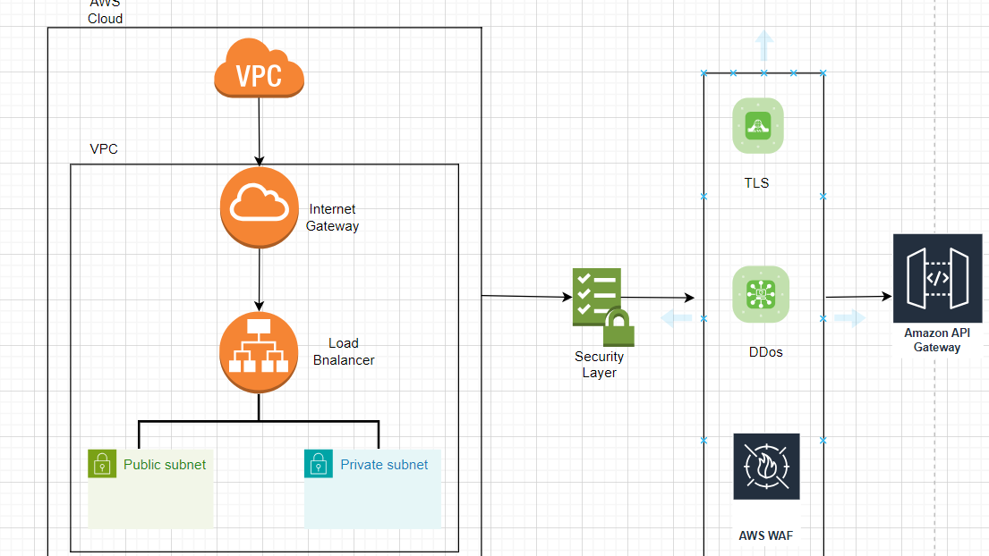
Design of Network/Security architecture
We recommend of implementing following security layer for ensuring secure and efficient communication between clients and servers.
Transport Layer Security (TLS)
Distributed Denial of Service (DDoS) Protection
AWS Web Application Firewall (WAF)

Slide 9
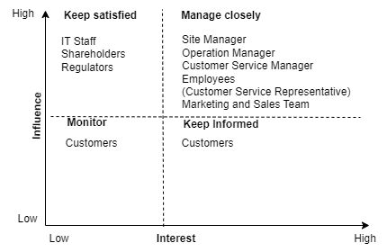
Industry Analysis and Stakeholder Identification
Cybersecurity Issues in Automotive Industry
Data privacy and security concerns
Network Security and Vulnerabilities
Secure AI Integration
Regulatory Compliance and Ethical Considerations.
Stakeholders Identification
Fig: Interest/Influence matrix

Slide 10
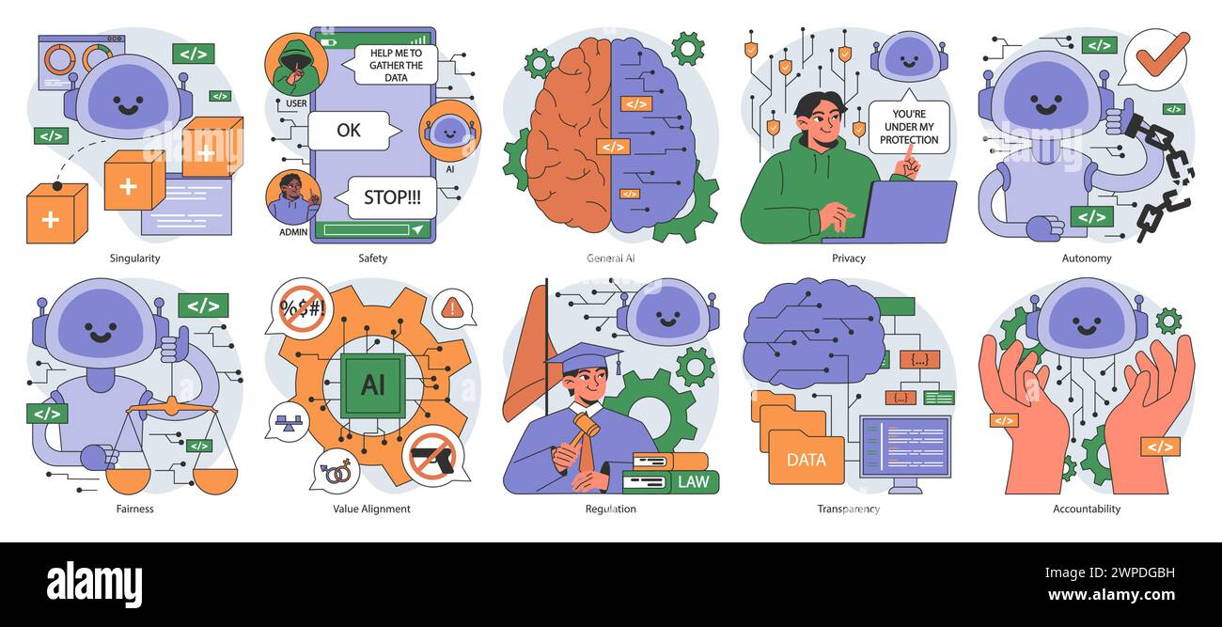
Framewrok for GenAI implementation
A structured set of principles, guidelines, and processes ensuring responsible AI use in digital asset protection
Core Principles
Transparency
Accountability
Fairness
Privacy
Human Oversight
Security
Transparency
Accountability
Privacy
Human Oversight
Security
Fairness

Slide 11
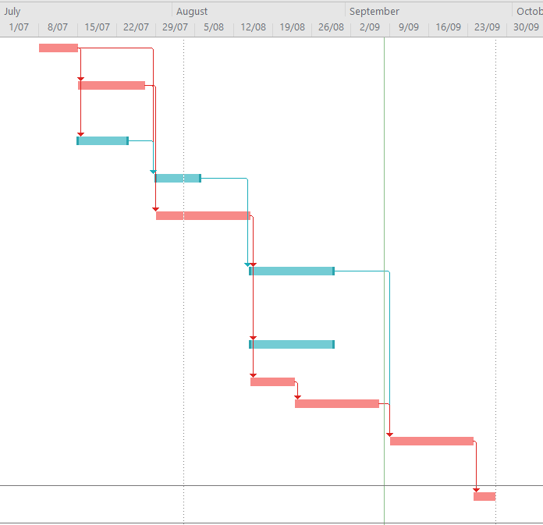
Framework Application
Ethical review process for shifting to GenAI: 8-step procedure
Data minimization in WaterTunnel website: 40% reduction in collected data
Incident response during AWS deployment issues: 24-hour resolution time

Slide 12
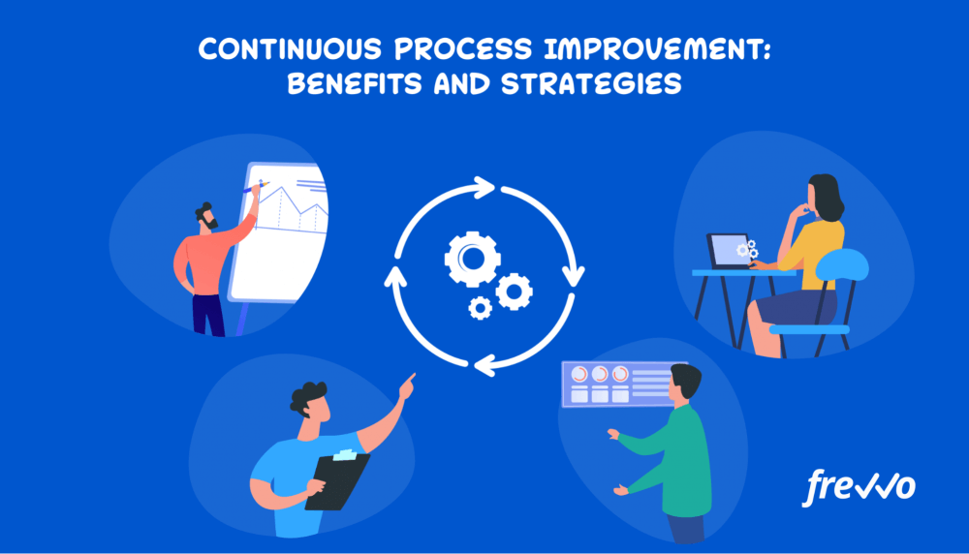
Ongoing framework use
Regular ethical audits: Bi-annual comprehensive reviews
Stakeholder engagement: Monthly feedback sessions, quarterly reports
Continuous updating of practices: Integration of new ethical AI guidelines

Slide 13
Risk Assessment and Mitigation plan
Process of identifying, analyzing, and evaluating risks to an organization's information systems and data.
Understanding the potential threats, vulnerabilities, and assets that are at risk.
Determining the likelihood and impact of these risks.
The goal is to prioritize risks, implement security controls, protection of sensitive information and minimizing the chances of cyberattacks

Slide 14
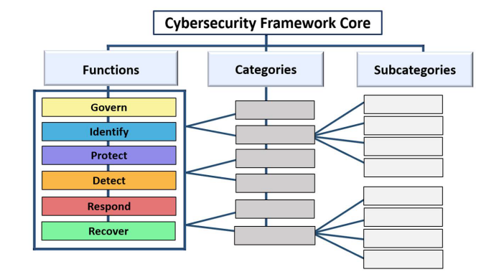
NIST Cyber-Security Framework
The Cybersecurity Framework (CSF) 2.0 is designed to help organizations of all sizes and other sectors to manage and reduce their cybersecurity risks
CSF Core, the nucleus of the CSF, is a taxonomy of high-level cybersecurity outcomes that can help any organization manage its cybersecurity risks.

Slide 15
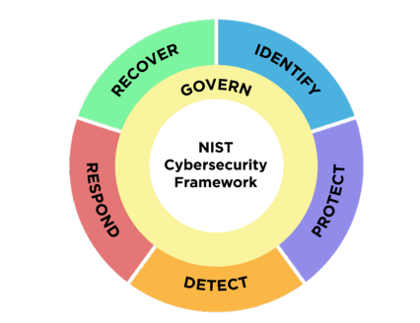
CSF Core Function
Govern (GV), focuses on establishing and communicating the organization's cybersecurity risk management strategy, policies, and governance structures.
Identify (ID) function helps organizations gain a clear understanding of their current cybersecurity risks by identifying critical assets such as data, hardware, software, systems, and people.
Protect (PR) function involves implementing safeguards to manage the identified risks, helping to prevent or reduce the likelihood of cybersecurity incidents.
Detect (DE) function ensures that organizations have the capabilities to identify and analyze potential cybersecurity threats or incidents in a timely manner.
Respond (RS) function comes into play, guiding organizations in taking action to contain and mitigate the impact of cybersecurity incidents.
Recover (RC) function focuses on restoring affected assets and operations following a cybersecurity incident.

Slide 16

Risk Assessment Methodology
Methodology Categorized into Four Phases:
Preparation: Identify system boundaries, assets at risk.
Assessment: Identify threats and vulnerabilities, analyze likelihood and impact
Mitigation: Select and implement controls.
Monitoring: Continuous monitoring and periodic review.

Slide 17

Risk Assessment Process
Risk Assessment Process (Based on NIST SP 800-30)
Identify Threats: External/internal threats (e.g., malware, phishing, insider threats)
Assess Vulnerabilities: System flaws (e.g., outdated software, weak passwords)
Evaluate Impact: Assess the likelihood and consequences of threats exploiting vulnerabilities
Document Findings: Clear, actionable risk assessment report for stakeholders.

Slide 18

Risk Assessment TVA Model
The Threat-Vulnerability-Asset (TVA) Model
TVA Relationships:
Threat: Potential events/actions that can exploit vulnerabilities (e.g., cyberattacks, insider threats)
Vulnerability: Weaknesses in the system (e.g., unpatched software, weak authentication) (Asaad and Saeed, 2022)
Asset: Resources that need protection (e.g., hardware, software, data)
Goal: Manage threats and vulnerabilities to protect assets.

Slide 19

Risk Mitigation Strategies
Technical Controls: Patching, encryption, firewalls.
Administrative Controls: Policies, training, access control.
Physical Controls: Surveillance, secure facilities
Continuous Monitoring: Ensure effectiveness of controls and adapt to new threats.

Slide 20
Collaborative Training and Awareness Program
.
Promoting Continuous Learning & Fostering Awareness in Generative AI
Continuous Learning Initiatives:
Regular webinars, workshops, and training on GenAI developments.
Frequent audits to ensure efficiency of AI systems.
Feedback & Adaptation:
Use of surveys, suggestion forms, and feedback meetings to gather insights.
Continuous improvement of training materials and policies based on feedback.
Collaboration:
Cross-functional teams: IT, Marketing, Compliance, Business working together.
Shared learning through workshops and feedback systems.

Slide 21
Cont..
Building a Culture of Awareness in GenAI
Awareness Campaigns
Regular communication via newsletters, emails, and meetings.
Internal initiatives: GenAI Awareness Week, AI Innovation Days.
Promotional Tools
Posters, infographics, and interactive displays to explain GenAI usage.
Strategic placement in high-traffic areas: offices, break rooms.
Stakeholder Involvement
Engaging cybersecurity experts, data scientists, and business leaders for a comprehensive GenAI strategy.

Slide 22

Delivered Technical Artifact
Website Design and Development
AI tool Development and Vulnerability Scan
Chatbot implementation

Slide 23
Conclusion
Provided the balanced perspective on GenAI, acknowledging the current skepticism and long-term potential.
Focused on ethical implementation, risk management and collaborative approaches for GenAI into cybersecurity.

